Slide 1

Sprocket Central Pty Ltd
Note: The data and information in this document is reflective of a hypothetical situation and client. This document is to be used for KPMG Virtual Internship purposes only.
Data analytics approach
[Division Name] - [Engagement Manager], [Senior Consultant], [Junior Consultant]

Slide 2
Agenda
Note: The data and information in this document is reflective of a hypothetical situation and client. This document is to be used for KPMG Virtual Internship purposes only.
Introduction
Data Exploration
Model Development
Interpretation

Slide 3
Introduction
Note: The data and information in this document is reflective of a hypothetical situation and client. This document is to be used for KPMG Virtual Internship purposes only.
Customer Data Analysis
Gender + Wealth segment.
Wealth segment + Age.
Gender + Job industry.
Job industry + Wealth segment.
Profit + Wealth segment + gender + age + car + tenure (Map)

Slide 4
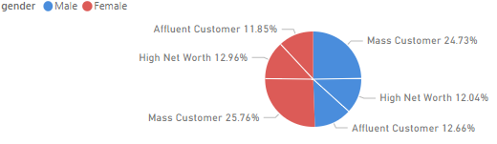
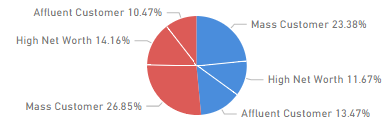
Data Exploration
Note: The data and information in this document is reflective of a hypothetical situation and client. This document is to be used for KPMG Virtual Internship purposes only.
Gender + Wealth segment
All visuals are for the past 3 years bike purchases
1. New customers shows growth potential.
2. Male vs Female are both identical, 50% each.
3. Mass customer segment shows highest %.
Customers
New Customers

Slide 5
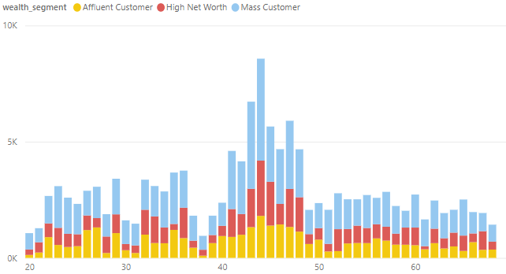
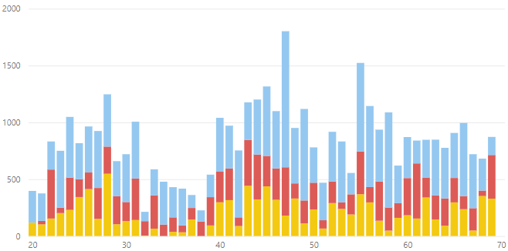
Data Exploration
Note: The data and information in this document is reflective of a hypothetical situation and client. This document is to be used for KPMG Virtual Internship purposes only.
Wealth segment + Age.
All visuals are for the past 3 years bike purchases
1. Customer shows highest % between 40 to 50.
2. New customer shows 3 age clusters
40 to 50
20 to 30
60 to 70
3. Dominance of Mass customer segment
Customer
New Customer

Slide 6
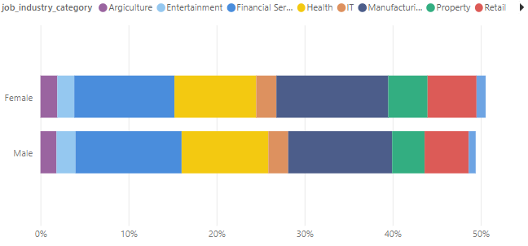
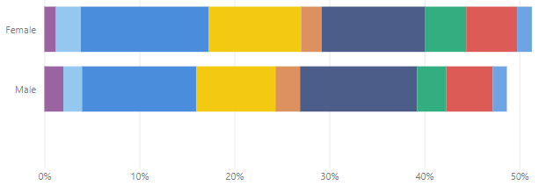
Data Exploration
Note: The data and information in this document is reflective of a hypothetical situation and client. This document is to be used for KPMG Virtual Internship purposes only.
Gender + Job industry.
All visuals are for the past 3 years bike purchases
Dominance in 3 industries for customer and new customer.
Dominance of 3 industries in gender as well
Top 3:
Financial Services
Manufacturing
Health

Slide 7
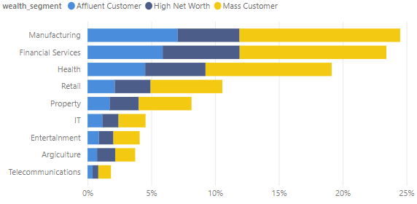
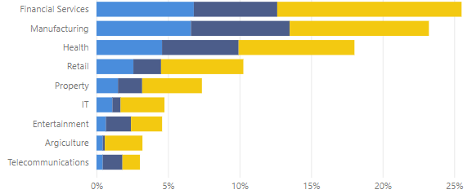
Data Exploration
Note: The data and information in this document is reflective of a hypothetical situation and client. This document is to be used for KPMG Virtual Internship purposes only.
Job industry + Wealth segment.
All visuals are for the past 3 years bike purchases
Dominance of the mass customer in the 3 top industries

Slide 8
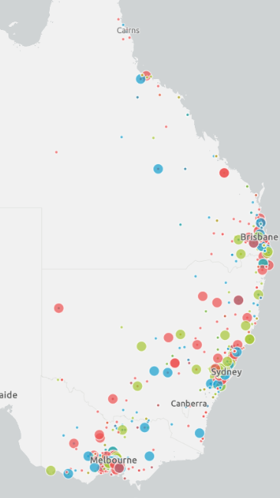
Map
Note: The data and information in this document is reflective of a hypothetical situation and client. This document is to be used for KPMG Virtual Internship purposes only.
Data Exploration
All visuals are for the past 3 years bike purchases
Size is profit
Color is wealth segment
Dominance of Major cities Melbourne, Sydney, Brisbane

Slide 9
Model Development
Note: The data and information in this document is reflective of a hypothetical situation and client. This document is to be used for KPMG Virtual Internship purposes only.
Customer segmentation is key in targeting customers, as shown in the data exploration.
Further segmentation can be done based on a classification algorithm.
Other data aspects can be also taken into account ( care ownership, tenure)

Slide 10
Interpretation
Note: The data and information in this document is reflective of a hypothetical situation and client. This document is to be used for KPMG Virtual Internship purposes only.
Interpreting data findings
Gender is not an important factor, as they are almost 50% each
New customers seems to show 3 age clusters
Gender is not shown as an important factor again, but the industries seem to be (Top 3)
Mass customer wealth segment seems to be dominate in all industries
New South Wales (NSW) & Victoria (VIC) are the best cities to target

Slide 11
Appendix
Note: The data and information in this document is reflective of a hypothetical situation and client. This document is to be used for KPMG Virtual Internship purposes only.

Slide 12
Appendix
Note: The data and information in this document is reflective of a hypothetical situation and client. This document is to be used for KPMG Virtual Internship purposes only.
Resources
To see dataset findings
Task 1 folder for the dataset notes
Task 2 folder Power BI file for the charts

